Slide 1
《新管理，新模式：探询与 肯定式的领导及其作用》 Appreciative Leadership
李海鹏 香港浸会大学
Hong Kong Baptist University
April 2013
Northeast Normal University
Changchun, China

Slide 2
管理模式，多种多样 Variety of Management Styles
管理目的: 有效地利用资源将员工动员起来, 共同实现所建目的. Goal: getting people together to accomplish desired goals using available resources efficiently and effectively
传统式 Traditional
多样式Multi-method approach
新型式New approach

Slide 3
Appreciative Leadership 肯定式领导
高兴Happy >
< 痛苦 Sad
handsaker.org

Slide 4
肯定式探寻 Appreciative Inquiry (AI)
Appreciative Inquiry
“对组织机构生活的肯定式探询” 于1987念发表 “Appreciative Inquiry into Organizational Life” first published by David Cooperrider at Case Western Reserve University in 1987; currently professor at the Weatherhead School of Management at Case Western Reserve University
证明是一种成功的管理方式 Proven to be successful management approach
Corporations: GTE/Verizon, AVON, John Deere…
Non-profit organizations: schools, universities, governments (United Nations) …

Slide 5
肯定式探寻 Appreciative Inquiry (AI)
寻找最佳成分 About the search for the best in people, their organizations, and the relevant world around them
提出能够增强员工的思考能力，预见性， 及肯定的潜在力等问题 Asking questions that strengthen an organization’s capacity to apprehend, anticipate, and heighten positive potential
Appreciative Inquiry Commons http://appreciativeinquiry.case.edu/intro/whatisai.cfm
http://timneufeld.blogs.com/.a/6a00d8341d38a453ef0147e2b60748970b-popup

Slide 6
肯定式领导 Appreciative Leadership
用关系能量将具有创造力的潜在力变成肯定力量 The relational capacity to mobilize the creative potential and turn it into positive power
使信任，能量，激情，表现等方面成为机构主流 to set in motion positive ripples of confidence, energy, enthusiasm, and performance
使周边世界具有肯定的意义 to make a positive difference in the world
Diana Whitney, et al. Appreciative Leadership: Focus on What Works to Drive Winning Performance and Build a Thriving Organization, 2010

Slide 7
肯定式领导Appreciative Leadership 5 种主要策略 5 Core Strategies
Appreciative Leadership 肯定式领导
Illumination 照明
Inclusion 包括
Inspiration 激励
Integrity 正直
Inquiry 探寻

Slide 8
肯定式领导Appreciative Leadership 5 种主要策略 5 Core Strategies
Inquiry 探询
Ask positive powerful questions – value 价值
Illumination 照明
Bring out the best of people and situation – strength 优点
Inclusion 包括
Engage with people to co-create the future – belonging 归宿
Inspiration 激励
Awaken the creative spirit – direction 方向
Integrity 正直
Make choices for the good of the whole – mission 宗旨
Diana Whitney, et al, 2010
Notes:
What gives you the most satisfaction at work? When do you feel good about work?
What caused us to be our best in this situation? Why did it work so well?
From me to us: a sense of belonging; different styles – taking turns talking
A vision that is not clear is not a vision at all. Aligning strength with vision.
Integrity – wholeness: ultimate measure of organizational success. Value-based decisions; keep your word.

Slide 9
肯定的变化 Positive Change
Inquiry → Cultivate character 发展性格
Illumination → Liberate potential 解放潜力
Inclusion → Foster collaborations 促进合作
Inspiration → Design structures 制定机构
Integrity → Facilitate change 协调变化
Diana Whitney, et al, 2010
bobbetcentrism.com

Slide 10
肯定的能量 Positive Energy
肯定为重点 Focusing on the positive
Everyone a talent 人人是天才
用其所長; 揚長避短;
Discovering strengths 发现优点
Self assessment 自我评估
Frame exercise 不断练习
positivethinkingprogram.com

Slide 11
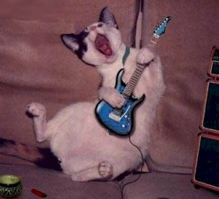
How to do it… 如何作。。。
Pride & Involvement 骄傲与参与
Trust & Respect 信任与尊敬
Teamwork
团队合作
Achievement & Success 成就与成功
sophlylaughing.blogspot.com

Slide 12
肯定 Appreciation
Does not always mean “money” 不一定为“钱”
Language of appreciation 肯定的语言
“Your report today was outstanding with the addition of the international element;” 你的报告。。非常好；
“I appreciate knowing you are a man of integrity;” 很高兴知道你是一个正直的人；
“Your outgoing nature makes you perfect for your job;” 你的外向性格很适合于这份工作；
“You play a critical role in the team-building efforts in our organization.” 你在本单位对团队建设起了重要作用；

Slide 13
推动与肯定 Promotion & Appreciation
基督教馆藏发展- 耶鲁大学-浸会大学十年合作项目 Chinese Christianity collection > Yale-BU 10 year agreement for collaboration
中医数据库项目- 获美国图书馆协会国际创新奖 Chinese medicine digital projects > 2012 American Library Association (ALA) Presidential International Innovation Library Project Citation Award
HKBUtube 与师生紧密合作，促进学习，教学，和科研
信息素养教学项目其前景 Information Literacy Program

Slide 14
(Student Productions)
Notes:
This year, we have 5 proposed action plans.

Slide 15
HKBUtube: Student Productions Usage Data
Number of Videos: 500
Video Views : 226,171 (July 2010-May 2012)
Notes:
This year, we have 5 proposed action plans.
This is the TDG project that I mentioned it several times in the past, so I think I’d better not to make you feel bored by repeating things here.

Slide 16
http://www.hkbu.edu.hk/lib/electronic/libdbs/mpd/index.html

Slide 17
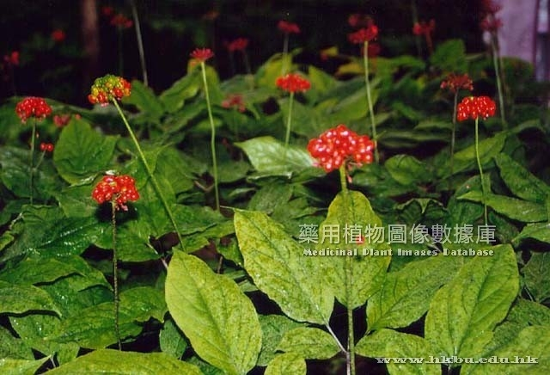
Chinese Medicine Plant Image Database – Usage Data
August 2011 – March15, 2013 Total：189,430
Country/Territory Visits (168 countries/territories)
Hong Kong 70,090
Taiwan 48,021
China 34,522
United States 11,738
Canada 3,444
Malaysia 2,952
Australia 2,229
Germany 1,998
Singapore 1,882
Macau 1,703
Ginsen 人參

Slide 18
HKBU Graduate Attributes 香港浸会大学毕业生的特质
Knowledge of academic specialty, & broad knowledge 专门学术知识和广义知识
Think critically and creatively 明辨性及创建性的思考
Trilingual and biliterate 多语能力
Information literacy, IT, numeracy, problem-solving 信息素养、科技信息、 算术、解决问题
Lifelong learners, inquiring spirit 终生学习者、探究精神
Responsible, ethical, global citizens 负责任、 合符道德、全球公民
Serve, lead and work in a team 服务、领导和在团队内工作

Slide 19
Information Literacy

Slide 20
Appreciative leadership
Leadership makes things happen. 领导会使事情发生
Appreciative leadership makes good things happen. 肯定的领导会使更好的事情发生
“If we were meant to talk more than listen, we would have two mouths and one ear.” 如果我们生来就要多讲少听，我们就应该有两张嘴巴，一只耳朵。 -- Mark Twain 马克。吐温
“The best way to predict the future is to create it!”预见未来的最佳办法是创造未来. -- Peter Drucker 彼得。德鲁克

Slide 21
Return on Investment – Assignment 回报= 作业
1. Choose a colleague you feel is deserving and give him/her a statement of affirmation within the next two weeks; 在下两周内，选一个同事并对他/她表示肯定；
2. Select a staff you can genuinely affirm and do so within the next two days. 在后两天内，选一名同事并对他/她表示真诚的肯定。

Slide 22
Thank you! 谢谢！

